Slide 1
Malware DB : Pre-processing Malicious Samples for Preliminary Analysis
Raphaela Mettig
Advisor: Dr. Golden G. Richard III

Slide 2
Project Overview
Database
Data bank containing information about our population of malware samples
Why do we want it?
Speed up the preliminary analysis of malware samples
Query specific malware from our lab’s repository

Slide 3
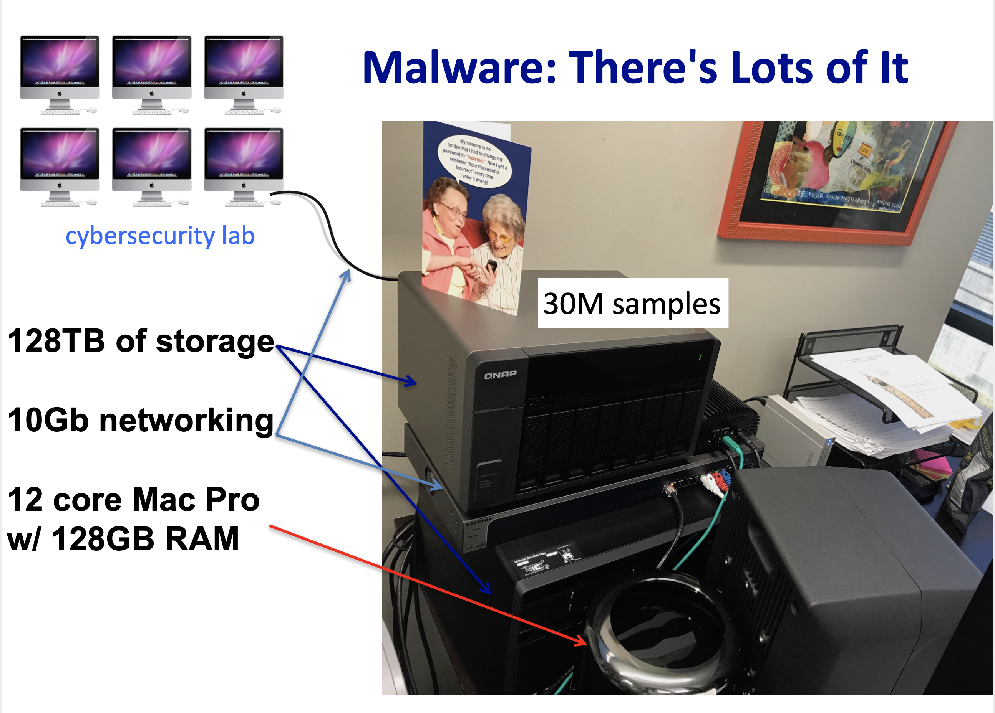

Slide 4

How Can We Use This Information?
Memory Forensics research
Ongoing research projects
Android
.NET
Swift
Hooktracer
Reverse engineering
Development of malware analysis tools

Slide 5
Malware Analysis Overview
What is Malware?
Malicious computer software
Steal credentials, spy on people, encrypt/delete files, cause physical damage to devices and critical infrastructure (yes, really), business disruption, revenue loss, and much more.
Why is it relevant for cybersecurity research?
One of the largest global cybersecurity threats
Quickly evolving threat

Slide 6
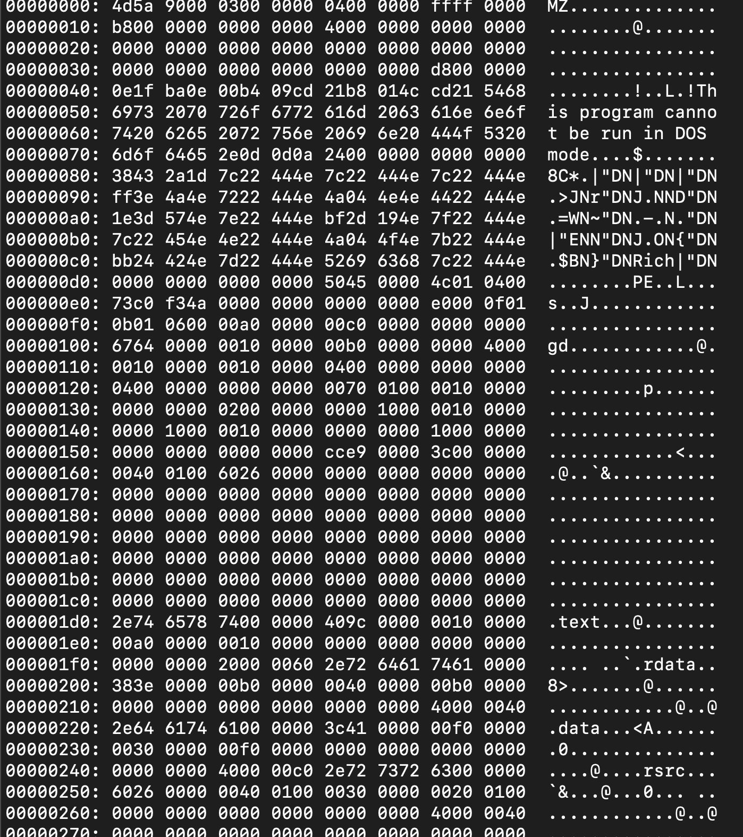

Malware Analysis Process
Fig.1: terminal output after dumping malware binary with xxd

Slide 7
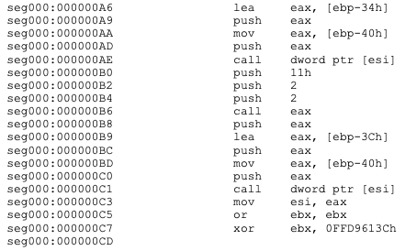
Malware Analysis Process
Static Analysis
Preliminary information collection – file information
Reverse Engineering – code analysis (disassembly)
Dynamic Analysis – examine malware’s behavior
Fig.2: Screen shot of SQL Slammer disassembly code

Slide 8
Malware Analysis Process
This is what we care about here
Static Analysis
Preliminary information collection – file information
Reverse Engineering – code analysis (disassembly)
Dynamic Analysis – examine malware’s behavior

Slide 9
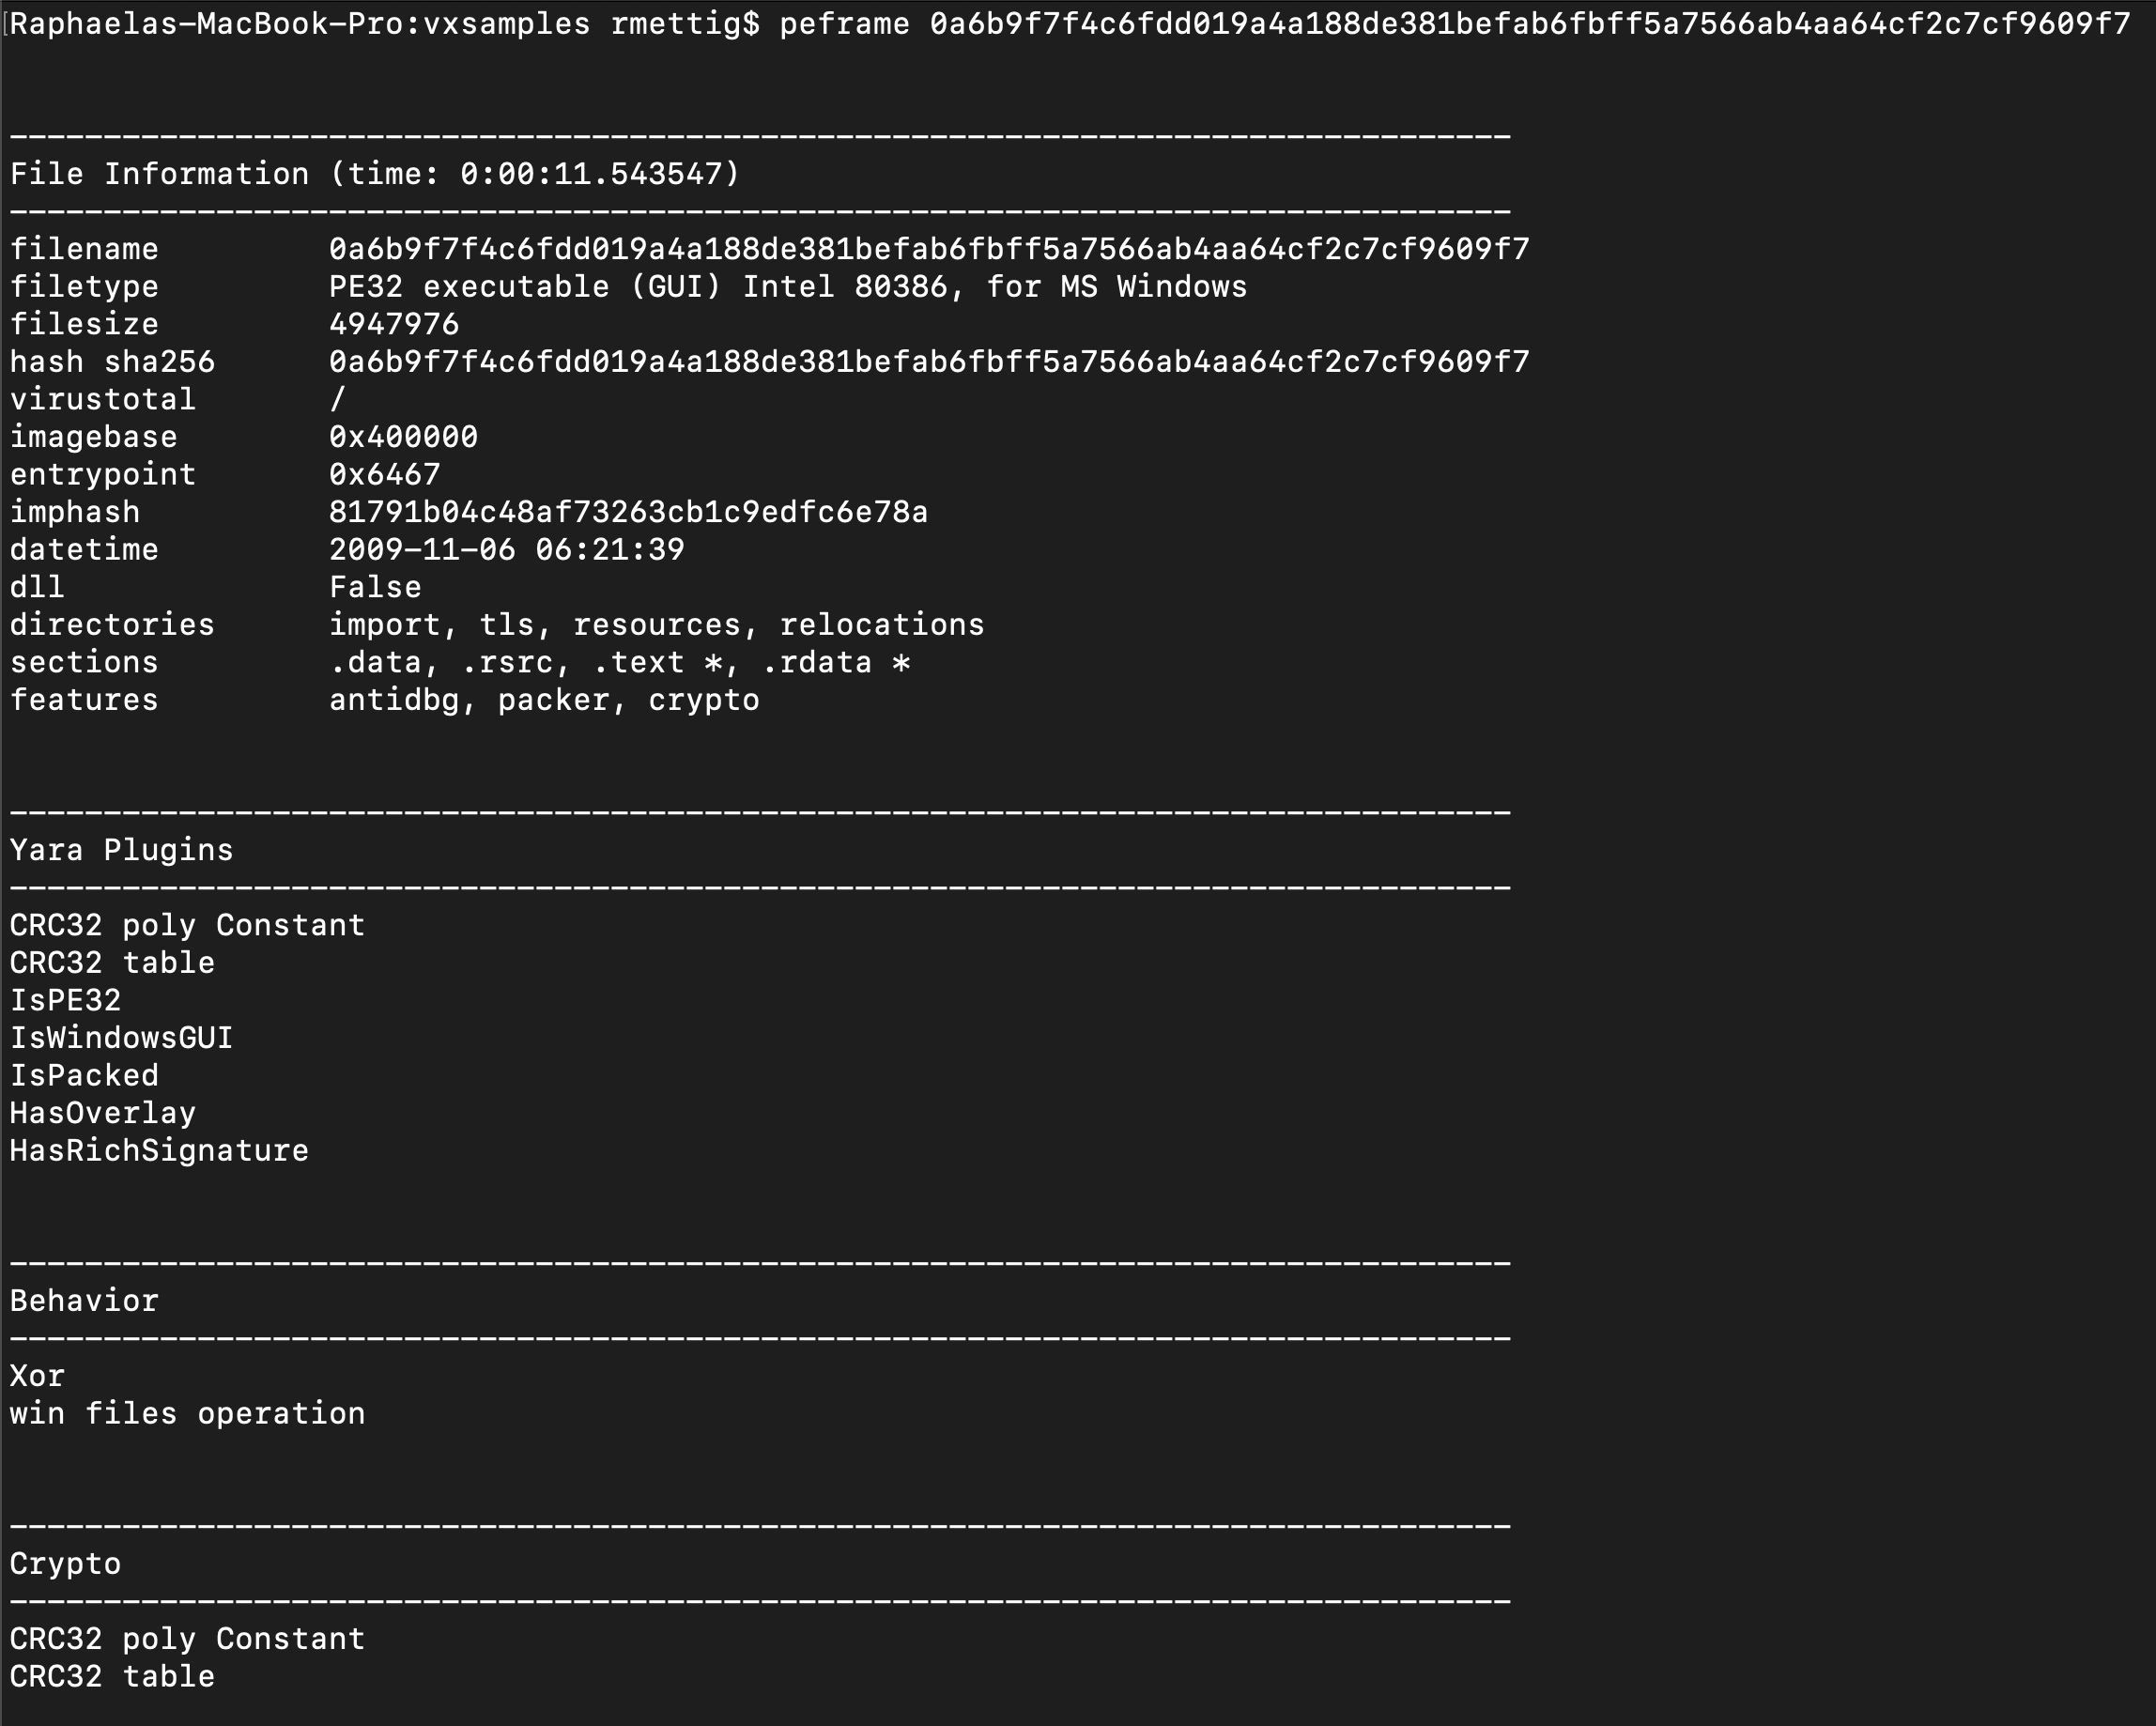
The Database
Multiple sources
Virus Share (>30 million samples)
VirusTotal
Personal collections
Public (open source) repositories
Information collected
General file information: path/name, size, magic number (extension/architecture)
File hashes: MD5, SHA1, SHA256
Portable Executable (PE) information: DLLs, URLs, IP addresses, strings
Fig.3: Terminal output after running PEFrame tool on malware sample

Slide 10
Stages of Data Collection
STAGE 1
STAGE 2
STAGE 3
General File Information
Format Specific Information
VirusTotal Scan
All samples.
On a file format basis.
Currently only Windows PE format files are supported (.exe, .dll, .sys, etc.)
All samples.
AV detection, nicknames, any extra relevant info.
Not yet implemented.

Slide 11
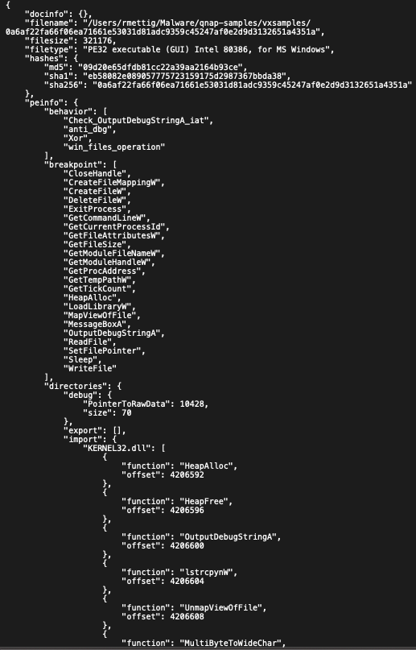
Project Status
Current focus:
Optimization for speed
PEFiles
In progress:
Implementing PEFrame
Testing new architecture
Challenges:
What is relevant?
Duplicates

Slide 12
Moving Forward
Analysis:
VirusTotal scans
Support for other file formats: ELF (Linux), Android malware, Mach-O, etc.
Collect statistical information on the samples
Most common DLLs, architectures, file types, etc.
Can we infer behavior from a set of characteristics?

Slide 13
Thank you! Questions?
Contact information:
Twitter: rmettig_
Github: raphasmrocha
Acknowledgements:
Dr. Golden Richard
Andrew Case
CCT Applied Cybersecurity Lab

